Slide 1
Module 6
Telecommunications Management Network

Slide 2
TMN
Necessity for interoperability basis for TMN
Need for management of more than just the
network components
Networks / subnetworks need to be managed
Services - internal and external need management
Business management needs to be addressed
TMN joint effort by ITU-T and ISO
  Notes

Slide 3
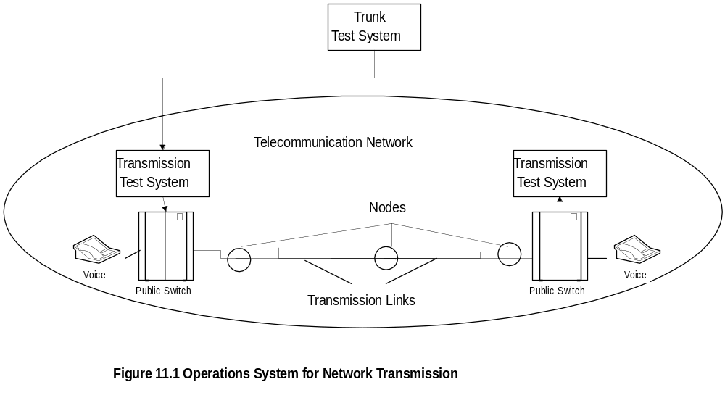
OS: Trunk Testing System
  Notes
Trunk is a logical connection between two switching
nodes
Periodic measurement of loss and S/N of all trunks
Failing threshold set for QoS; failing trunks removed
out of service before the customer complains

Slide 4
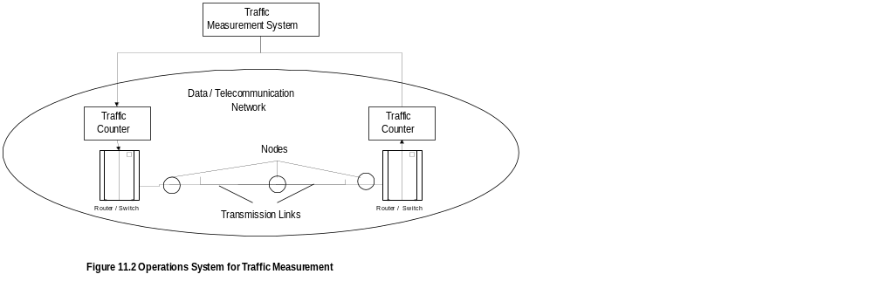
OS: Telephone Switch Traffic
  Notes
Traffic monitored at switch appearance
Call blocking statistics obtained
Traffic and call-blocking statistics provide data
for planning
Importance of Operations, administration, mainte-
nance, and provisioning

Slide 5
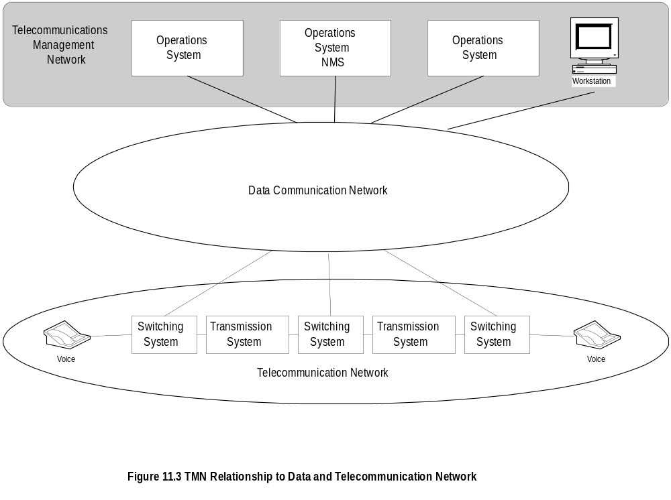
TMN Conceptual Model
  Notes

Slide 6
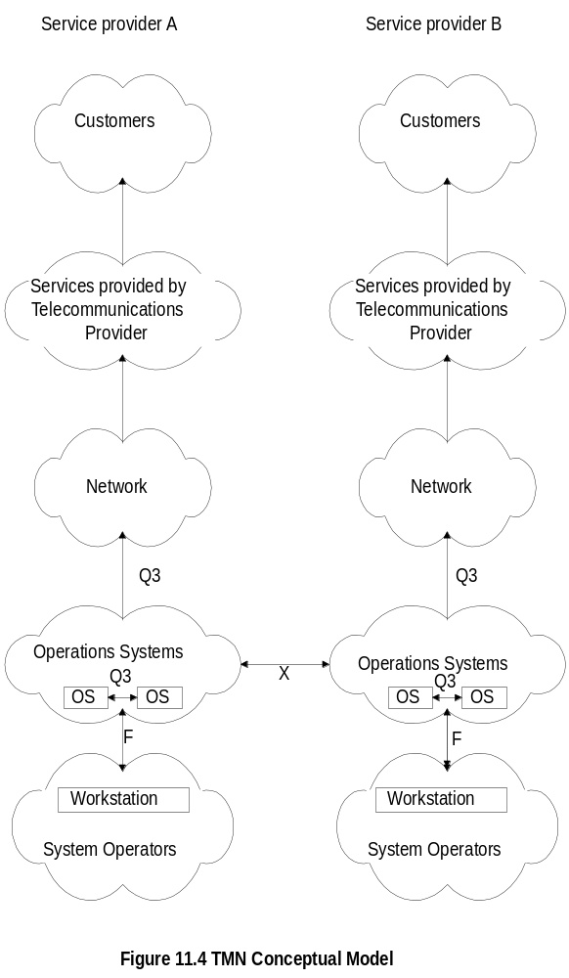
TMN Conceptual Model
  Notes
Components
Interfaces

Slide 7
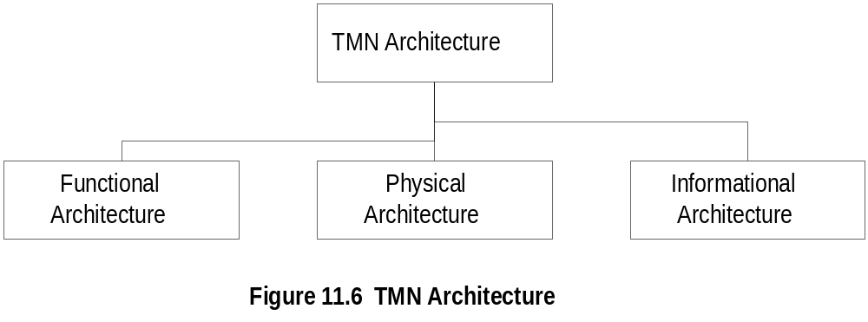
TMN Architecture
  Notes
Functional architecture:
  Functional modules or blocks
  Reference points between modules
Physical architecture:
  Physical blocks
  Physical interfaces between the blocks
Informational architecture:
  Information exchange between entities
  Object oriented

Slide 8
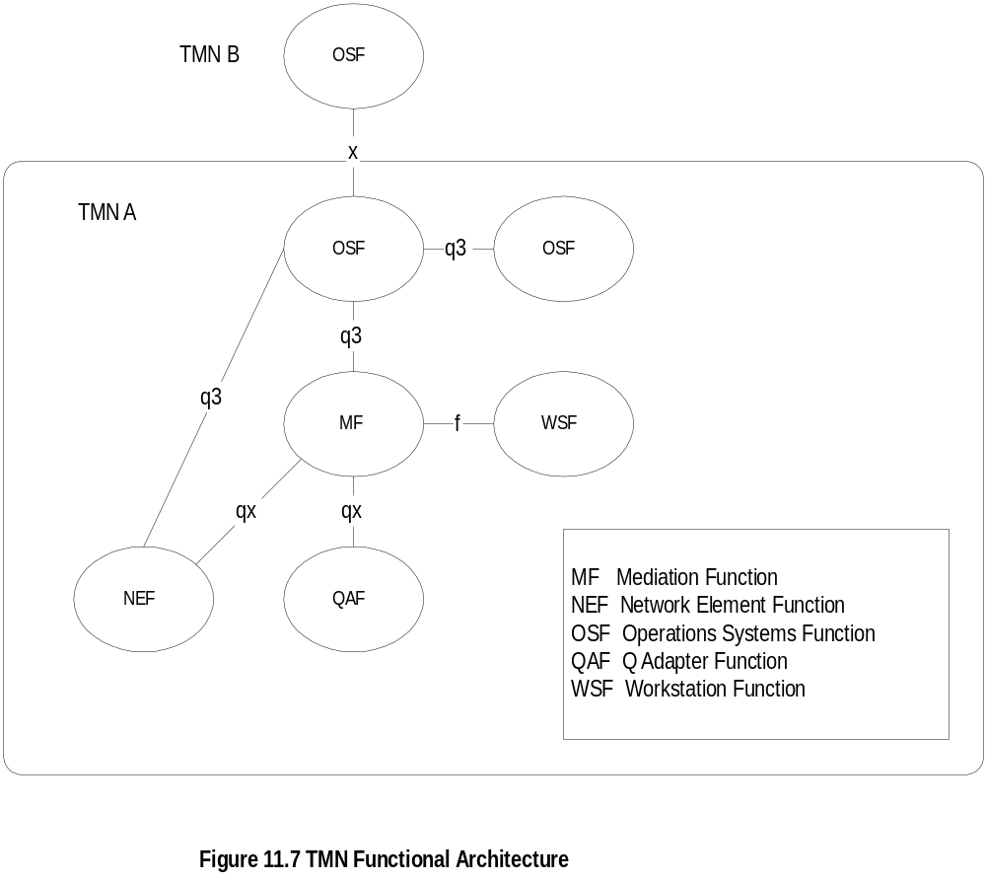
Functional Architecture
  Notes
OSF: Functions performed by Operations
systems: e.g., NMS, testing, accounting, trouble
tracking
NEF: Functions needed to support network
elements;network elements themselves are not
part of TMN: e.g., NM agent, MIB, collision rate

Slide 9
Functional Architecture
  Notes
MF: Operations on the information between network
elements; e.g. filtering, protocol conversion
MF can be shared between multiple OSSs;
e.g. RMON
WSF:Human-TMN activities interface; e.g., GUI
QAF: Adapter function to accommodate non-TMN
entities; e.g. proxy server, SNMP-to-CMIP

Slide 10
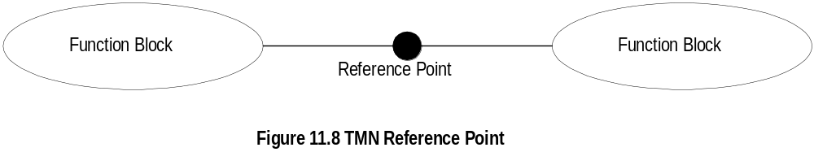
TMN Reference Point
  Notes
Function blocks connected by conceptual
interfaces, called reference point
Designated by lower case letters (upper case
letter for physical interfaces)
x: Interface between operations systems that
belong to different domains; e.g., interface between
two NMSs belonging to two different domains
q3: Interface between two OSFs in the same domain
qx: Interface between mediation function such as
RMON and agent in the network element
f: Interface to the workstation

Slide 11
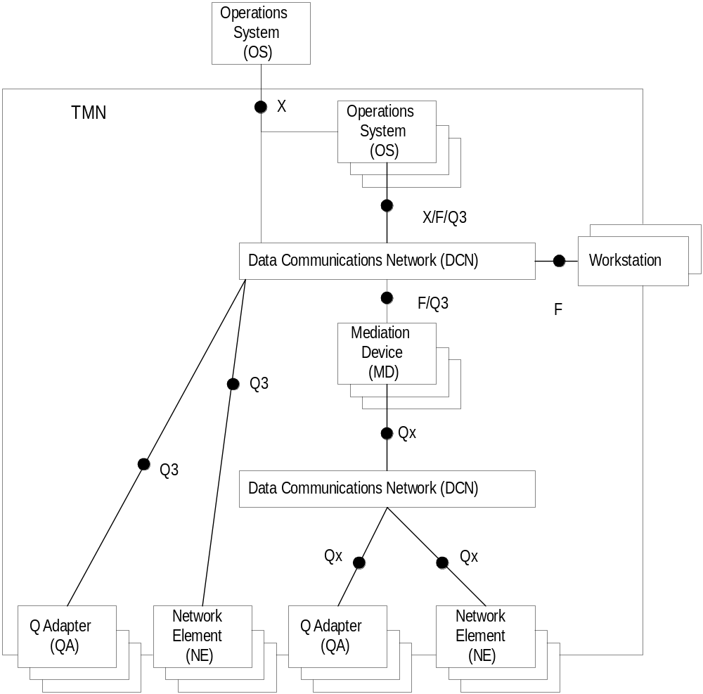
Physical Architecture
  Notes

Slide 12
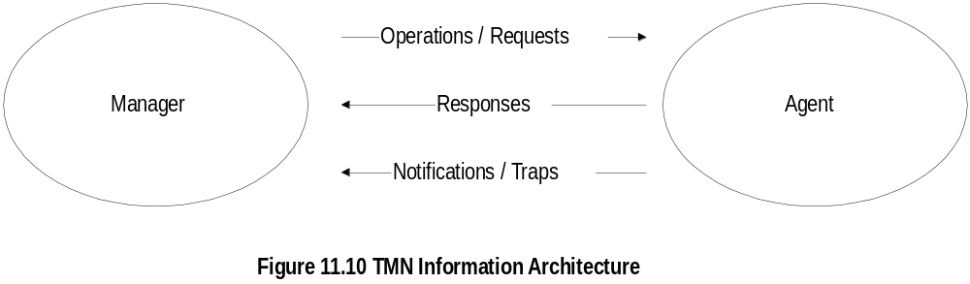
Information Architecture
  Notes

Slide 13
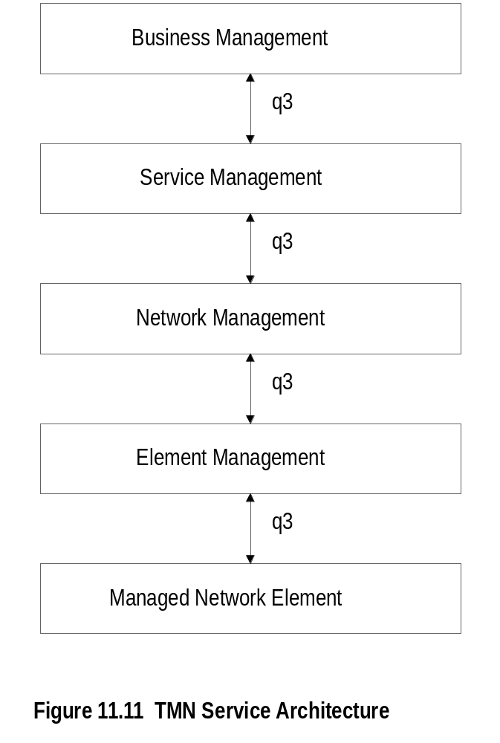
Service Architecture
  Notes

Slide 14
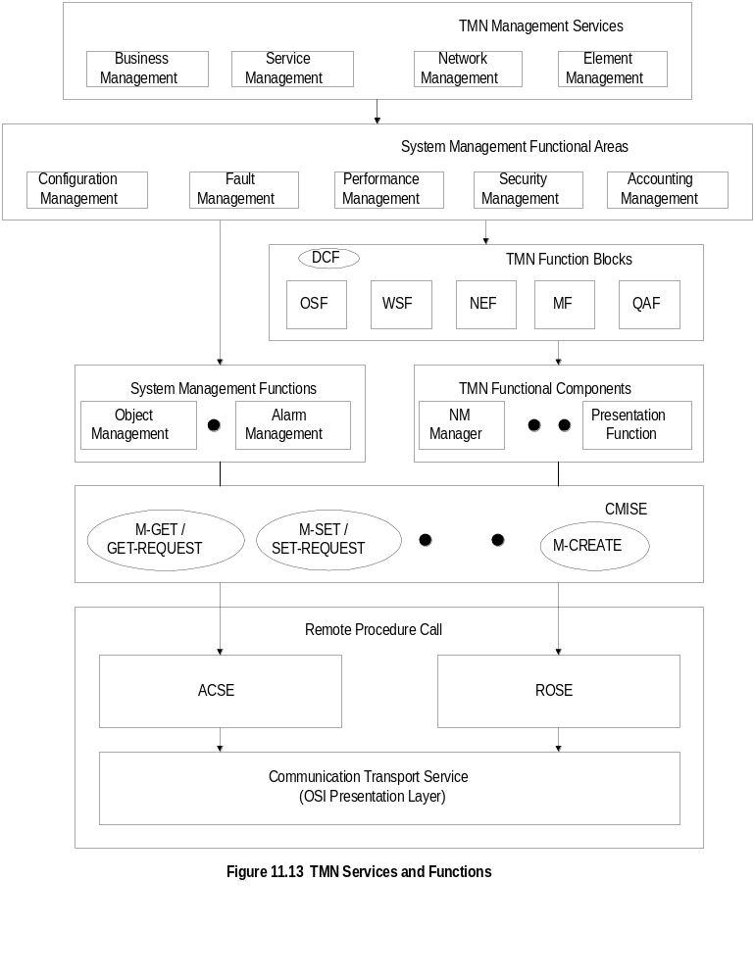
TMN Services & Functions
  Notes

Slide 15
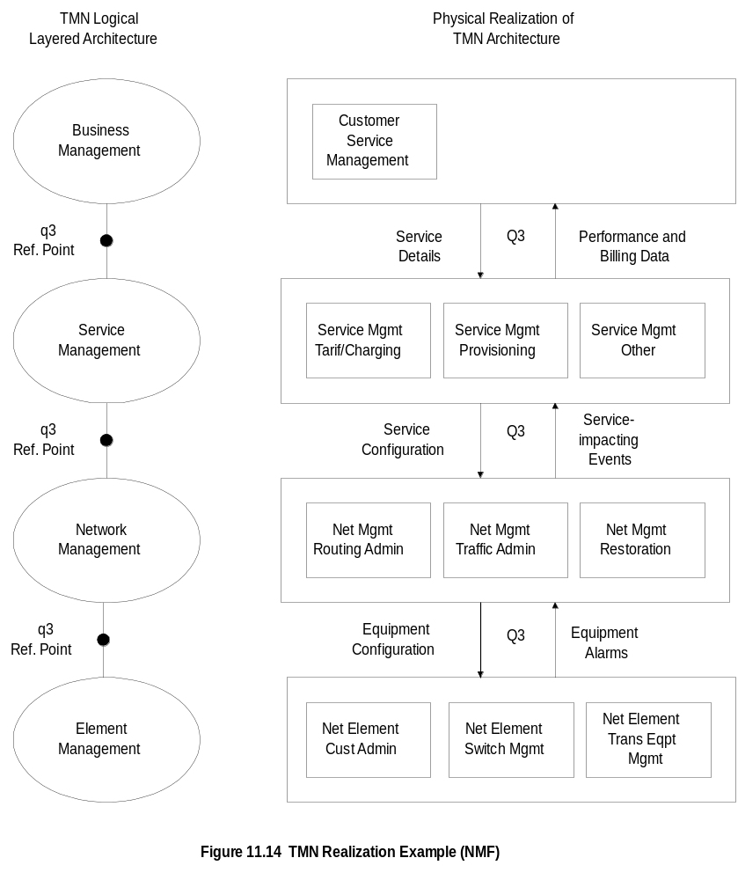
Example (NMF)

